Slide 1
Visualizing and describing spatial data
GEOG4300 /6300: Intro to data science
Prof. Jerry Shannon

Slide 2
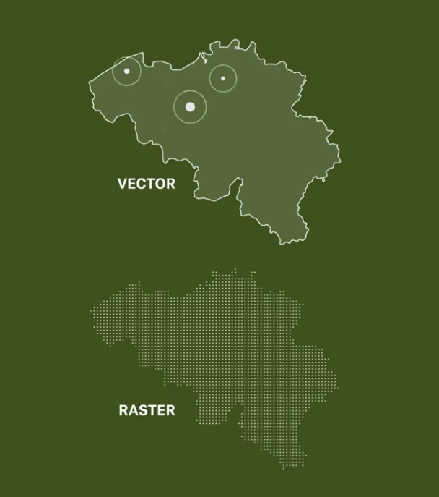
Review:
How are vector and raster data different?

Slide 3
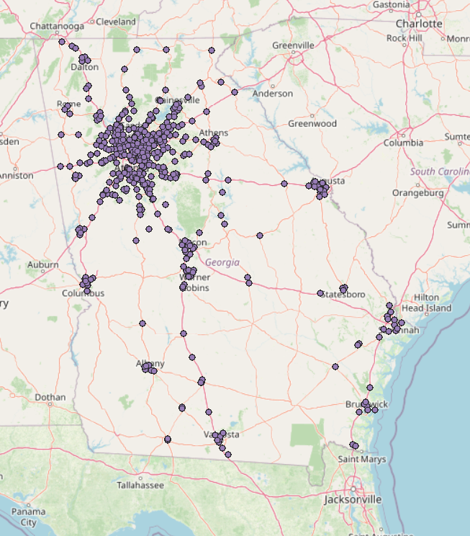
Descriptive stats for spatial data
Where is/are the center(s)?
How far is the spread?
Waffle Houses in Georgia

Slide 4
Descriptive stats for spatial data
Where is/are the center(s)?
How far is the spread?
How is this different than mean/standard deviation?
Waffle Houses in Georgia

Slide 5
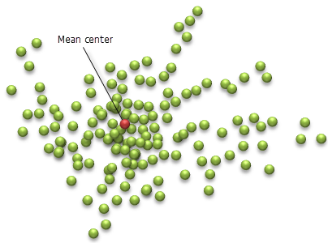
Mean center
What’s the average longitude and latitude of each point?
Open
“wh_Georgia_Safegraph_xy.csv”
Calculate the mean center

Slide 6
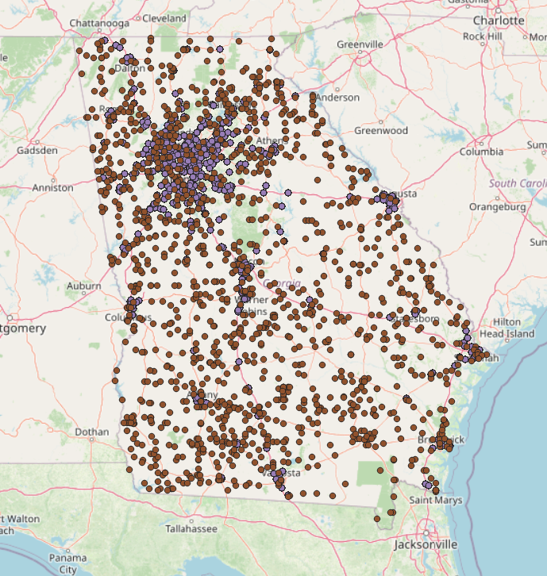
Interpreting mean center
Open “tornado_pointsSE.csv”.
Save just Georgia points (ST is “GA”) in a new tab. What’s the mean center of those points?
How does it compare to Waffle House?
What does that tell us?

Slide 7
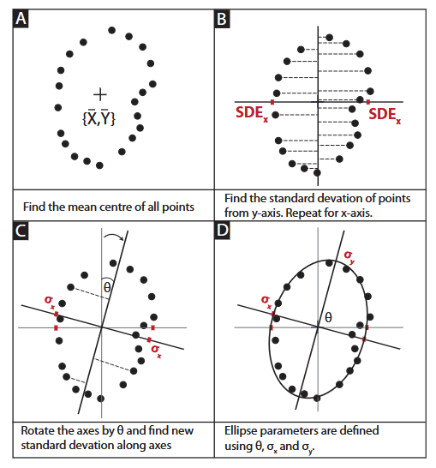
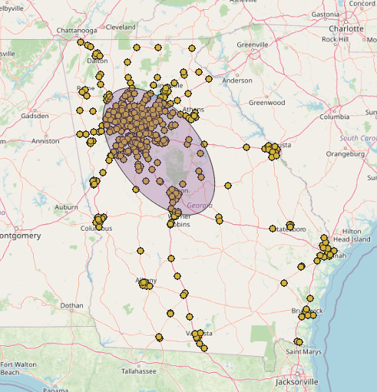
Measuring spread:
Standard deviation ellipse
eolog
The Geological Society https://www.geolsoc.org.uk/~/media/Files/GSL/shared/Sup_pubs/2015/18849.pdf

Slide 8
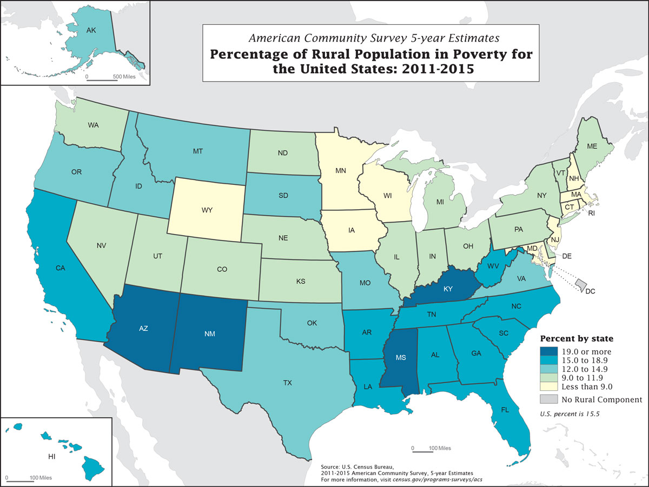
Maps 101: Choropleth map
US Census

Slide 9
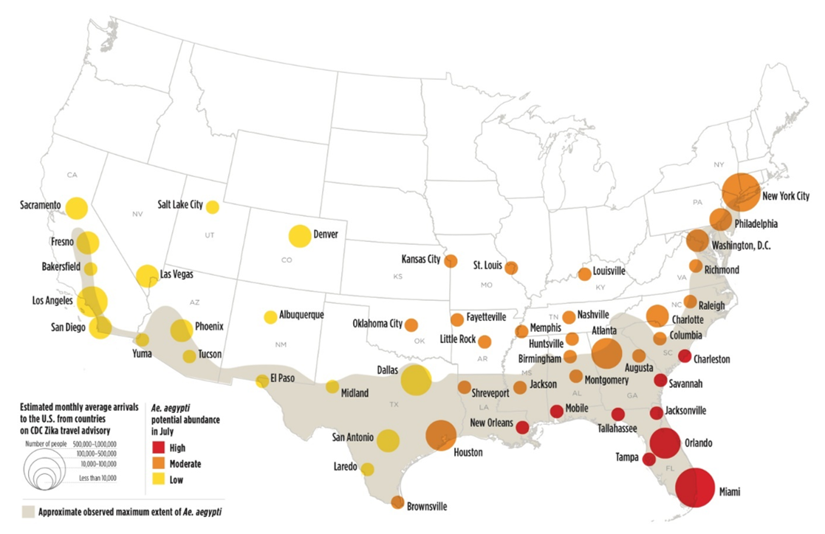
Maps 101: Graduated symbol
Penn State Geography

Slide 10
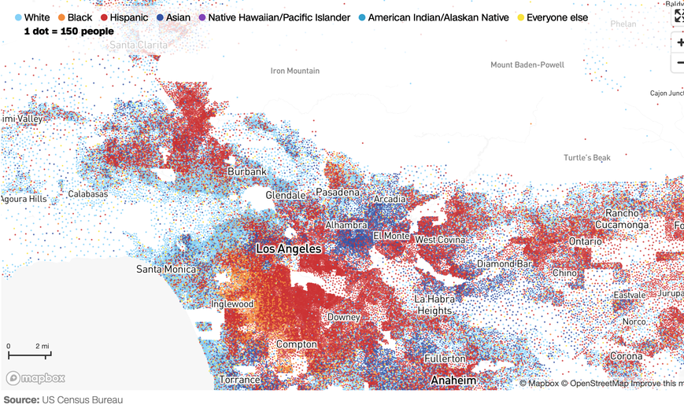
Maps 101: Dot density map
Flowing Data

Slide 11
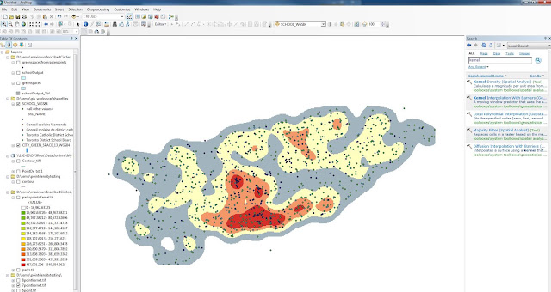
Maps 101: Kernel density map (heatmap)
University of Toronto Libraries

Slide 12
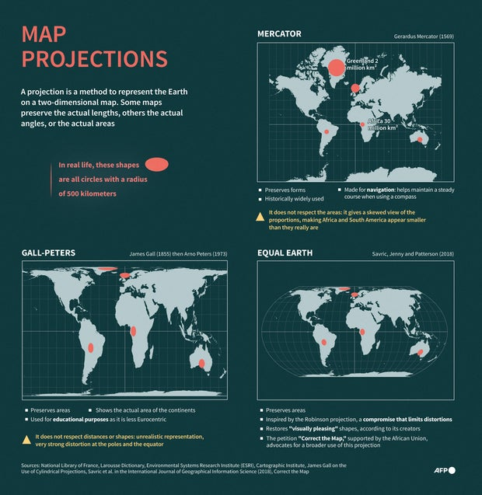
Maps have projections

